Slide 1

CSC432 – information Security
Dr. Adnan Ahmad

Slide 2
Stream Ciphers and RC4

Slide 3
Modern Ciphers
Stream Ciphers
Encrypts a digital data stream one bit or one byte at a time
One time pad is an example; but practical limitations
Typical approach for stream cipher:
Key (k) used as input to bit-stream generator algorithm
Algorithm generates cryptographic bit stream (k_{i}) used to encrypt plaintext
Users share a key; use it to generate key-stream

Slide 4
Example
Encryption:
1001001 1000110 plaintext
1010110 0110001 key
0011111 1110110 ciphertext
Decryption:
0011111 1110110 ciphertext
1010110 0110001 key
1001001 1000110 plaintext

Slide 5
Modern Ciphers
Stream Ciphers

Slide 6
Random Numbers
Many uses of random numbers in cryptography
Nonce as Initialize Vector
Session keys
Public key generation
Keystream for a one-time pad
In all cases its critical that these values be
statistically random, uniform distribution, independent
unpredictability of future values from previous values
Care needed with generated random numbers

Slide 7
Pseudorandom Number Generators (PRNGs)
Often use deterministic algorithmic techniques to create “random numbers”
although are not truly random
can pass many tests of “randomness”
Known as “Pseudorandom Numbers”
Created by “Pseudorandom Number Generators (PRNGs)”

Slide 8
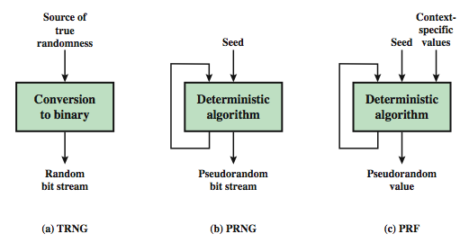
Random & Pseudorandom Number Generators
True Random Number Generator (TRNG)
Pseudorandom Number Generator (PRNG)
Pseudorandom Function (PRF)

Slide 9
Origins of Rivest Cipher
A symmetric key stream cipher designed in 1987 by Ron Rivest
It was kept as a trade secret by RSA Security
In September 1994, the RC4 algorithm was anonymously posted on the Internet
Variable key-size stream cipher with byte-oriented operations
variable size key: 1 to 256 bytes (8 to 2048 bits)
Currently used with a key of 128 bits
Used in secure web browsing (SSL/TLS) and wireless LANs (WEP)
Simple and efficient implementation

Slide 10
RC4
The RC4 Algorithm
Parameters and Variables
Variable length key, K, from 1 to 256 Bytes
State vector, S, 256 Bytes
S contains a permutation of all 8-bit numbers from 0 through 255
Temporary vector, T, 256 Bytes
A byte from keystream, k, generated from S

Slide 11
RC4
The RC4 Algorithm
Steps
Initialize S to values 0 to 255; initialize T with repeating values of key, K
Use T to create initial permutation of S
Key Scheduling Algorithm (KSA)
Permute S and generate key stream, k from S
Pseudo Random Number Generation (PRGA)
Encrypt a byte of plaintext, p, by XOR with k

Slide 12
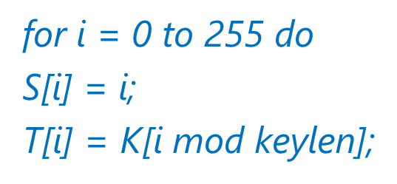
RC4
The RC4 Algorithm
Initial State of S and T

Slide 13
RC4
KSA
Initial Permutation of S (also known as Key Scheduling Algorithm)
j = 0;
for i = 0 to 255 do
j = (j + S[i] + T[i]) mod 256;
Swap (S[i], S[j]);

Slide 14
RC4
PRNG
i, j = 0;
while (true)
i = (i + 1) mod 256;
j = (j + S[i]) mod 256;
t = (S[i] + S[j]) mod 256;
k = S[t];
Swap (S[i], S[j]);

Slide 15
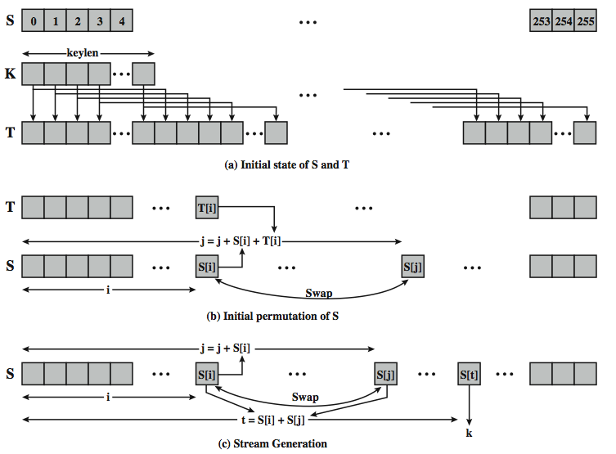

Slide 16
RC4
The RC4 Algorithm
Stream Generation Demonstration
To encrypt: C = P XOR k
To decrypt: P = C XOR k
https://www.youtube.com/watch?v=KM-xZYZXElk

Slide 17
RC4
The RC4 Algorithm
Some example
Using each array of size 8, generate the RC4 bit stream using the key “Security”.

Slide 18
RC4
Strengths
Difficulty of knowing the state
Difficulty of knowing which location in the state table is used to select each value in the sequence
Encryption in software is about 10 times faster than DES

Slide 19
RC4
Weaknesses
Vulnerable to analytic attacks to the state table
Theoretical attacks performed on the RC4 algorithm; one of the best known has been developed by Fhlurer, Martin and Shamir
There are some weak keys, so the initial 512 bytes of output is dropped in order to defeat weak key attacks and other attacks related to key schedule
None of these approaches is practical against RC4 with a reasonable key length, such as 128 bits

Slide 20
Block vs Steam Ciphers
With a properly designed PRNG, a stream cipher can be as secure as block cipher of comparable key length
Stream ciphers are almost always faster and use far less code than block ciphers
Block ciphers can reuse keys
However, if two plaintexts are encrypted with the same key using a stream cipher, then cryptanalysis is often quite simple
If the two ciphertext streams are XORed together, the result is the XOR of the original plaintexts
If the plaintexts are text strings, credit card numbers, or other byte streams with known properties, then cryptanalysis becomes more easy

Slide 21
Block vs Steam Ciphers
For applications that require encryption/decryption of a stream of data, such as over a data communications channel or a browser/Web link, a stream cipher might be the better alternative
For applications that deal with blocks of data, such as file transfer, e-mail, and database, block ciphers may be more appropriate
However, either type of cipher can be used in virtually any application

Slide 22
RC4 and WEP
WEP is a protocol using RC4 to encrypt packets for transmission over IEEE 802.11 wireless LAN.
WEP requires each packet to be encrypted with a separate RC4 key.
The RC4 key for each packet is a concatenation of a 24-bit IV (initialization vector) and a 40 or 104-bit long-term key.
RC4 key: IV (24) Long-term key (40 or 104 bits)
l

Slide 23
802.11 frames using WEP
l
Header IV Packet ICV FCS
encrypted
ICV: integrity check value (for data integrity)
FCS: frame check sequence (for error detection)
Both use CRC32

Slide 24
WEP Vulnerability
WEP protocol has several flaws but not the RC4 itself
Short IV length
24 bits IV not sufficient
Clear text IV as part of the key
24 bits of every key in cleartext
Collect and analyze IVs to extract the WEP key
Weak IVs
Some generated IVs do not provide enough randomness
Can be used to extract the key
Notes:
To form the stream key for en/decryption (which are identical), RC4 continues to shuffle the permutation array S by continuing to swap each element in turn with some other entry, and using the sum of these two entry values to select another value from the permutation to use as the stream key, which is then XOR’d with the current message byte.
A number of papers have been published analyzing methods of attacking RC4, but none of these approaches is practical against RC4 with a reasonable key length, such as 128 bits.
A more serious problem occurs in its use in the WEP protocol, not with RC4 itself but the way in which keys are generated for use as input to RC4.
Currently RC4 its regarded as quite secure, if used correctly, with a sufficiently large key.

Slide 25
THANKS

